Slide 1
Resume Classification using NLP

Slide 2
Group Members-
Mr. Shreyash Subhash Hiwale
Miss. Pragati Rajendra Swami
Mohammed Sohail Hussain

Slide 3
Introduction-
The amount of resume that companies get is insane. It takes a lot of time to check every single resume manually.
In order to reduce this effort, Resume classification can be done using Machine Learning.
The document classification solution should significantly reduce the manual human effort in the HRM. It should achieve a higher level of accuracy and automation with minimal human intervention Sample Dat Set.

Slide 4
Data set-
The data set contains 79 resumes divided into 4 categories. They are –
Peoplesoft resumes
React resumes
SQL Developer Lightning insights resumes
Workday resumes
The resume are in 3 different formats-
.doc
.docx
.pdf

Slide 5
Extraction-
The task involved processing files with varied extensions: .docx and .doc formats.
Utilized the Python-docx library to extract content from .docx files seamlessly.
For .doc files, employed the Win32 library to open and then save them as .docx extensions.
After conversion, utilized Python-docx to read the newly created .docx files.
Leveraged the Pyresparser library to efficiently extract skills from resumes.
This approach ensured comprehensive handling of diverse file formats, facilitating seamless extraction and analysis of resume data.
By combining these libraries, the workflow enabled efficient processing of both .docx and .doc files, ensuring compatibility and streamlined extraction of pertinent information.

Slide 6
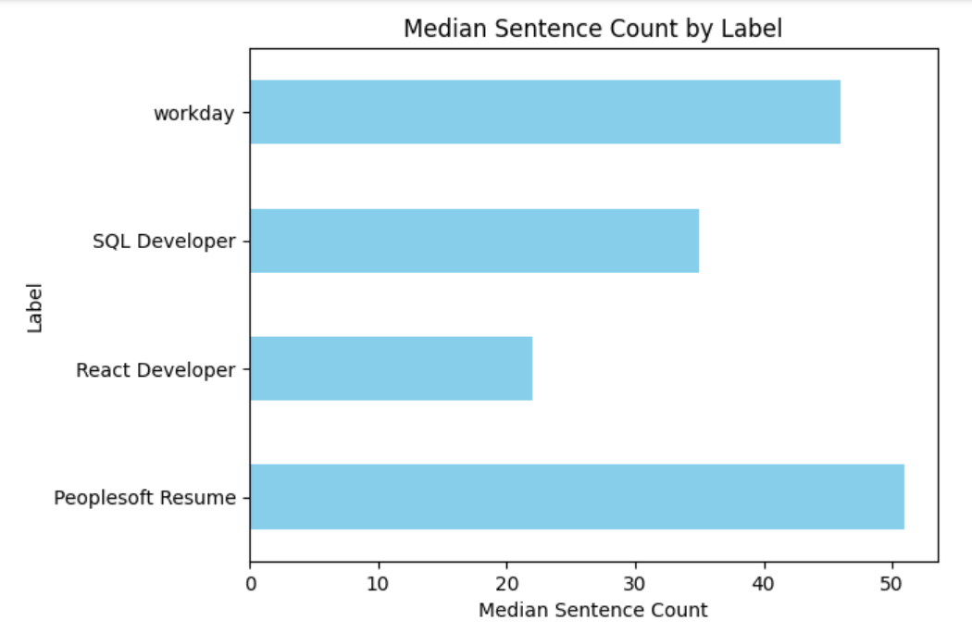
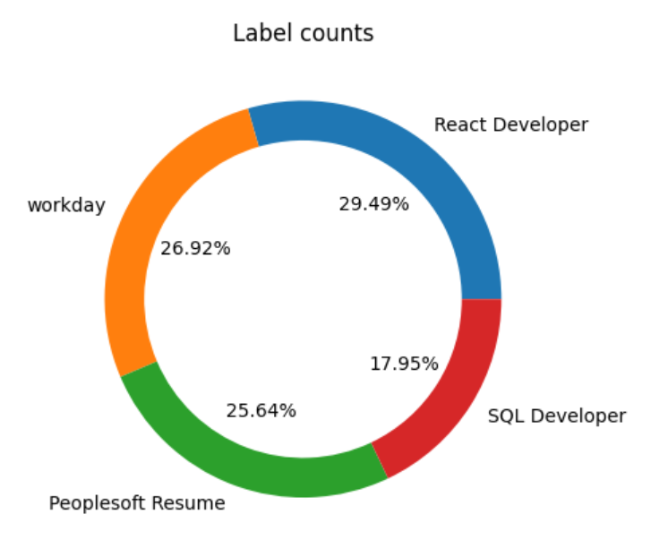
EDA and Data Pre-processing

Slide 7
Text Processing-
Remove patterns.
Remove Urls
Text cleaning – Punctuations, lowercase, Square brackets, etc
Removing Emogis
Applying Tokenization
Removing stopwords
Applying Lemmatization
Applying CountVectorizer
Applying CountVectorizer on NGrams

Slide 8
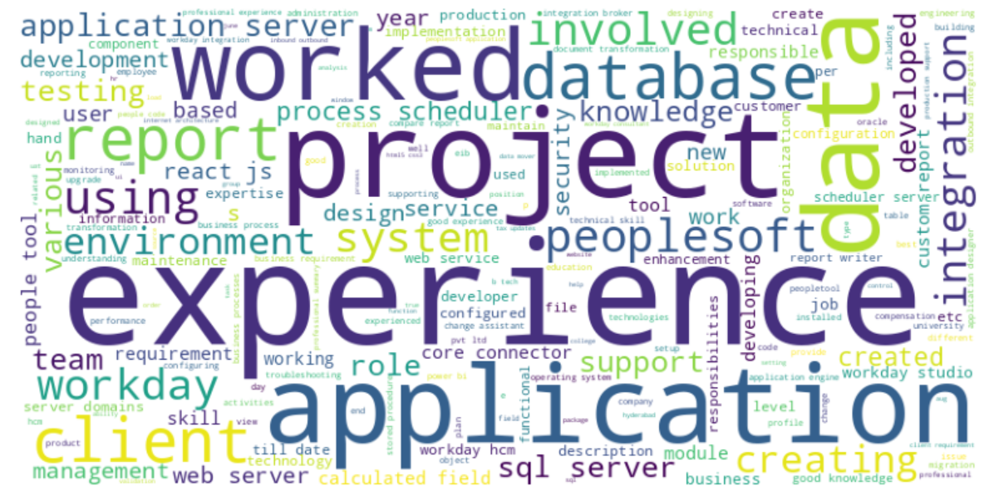
Most used words-

Slide 9
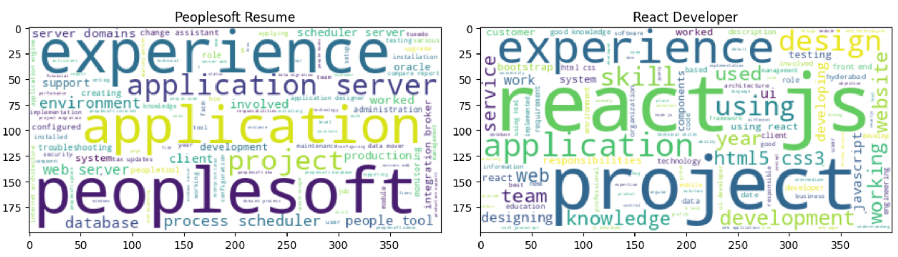
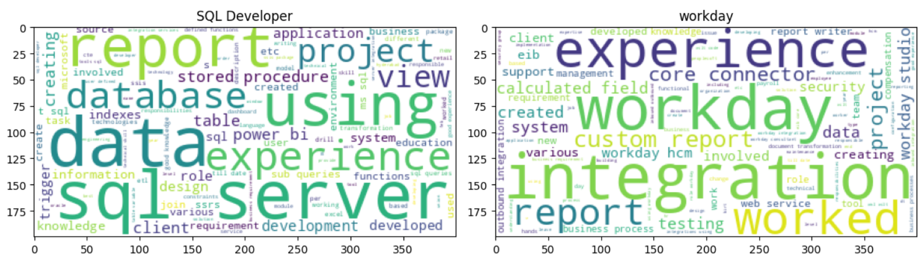
Word cloud-

Slide 10
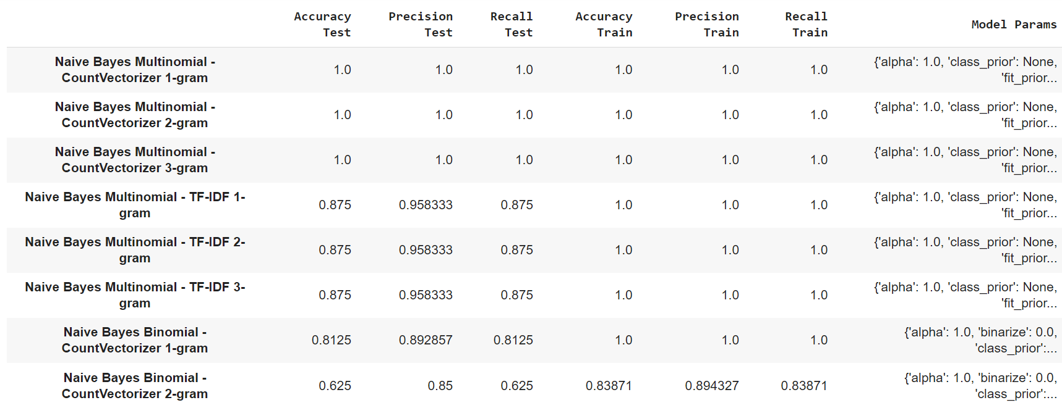
Model building-

Slide 11
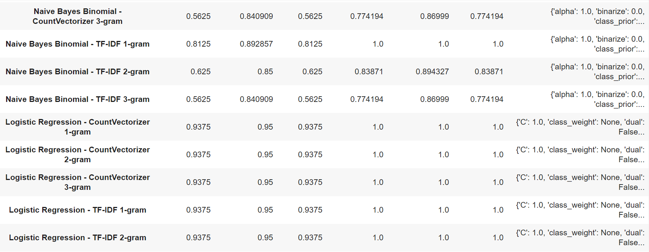

Slide 12
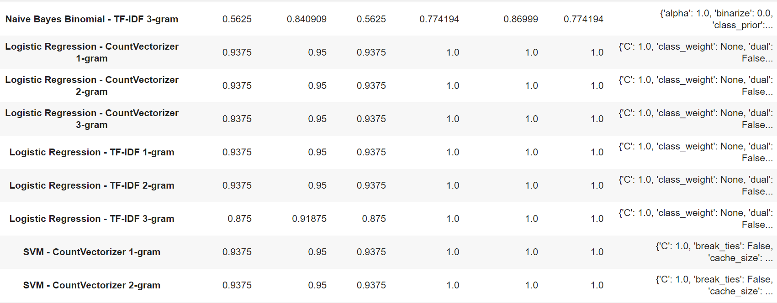

Slide 13
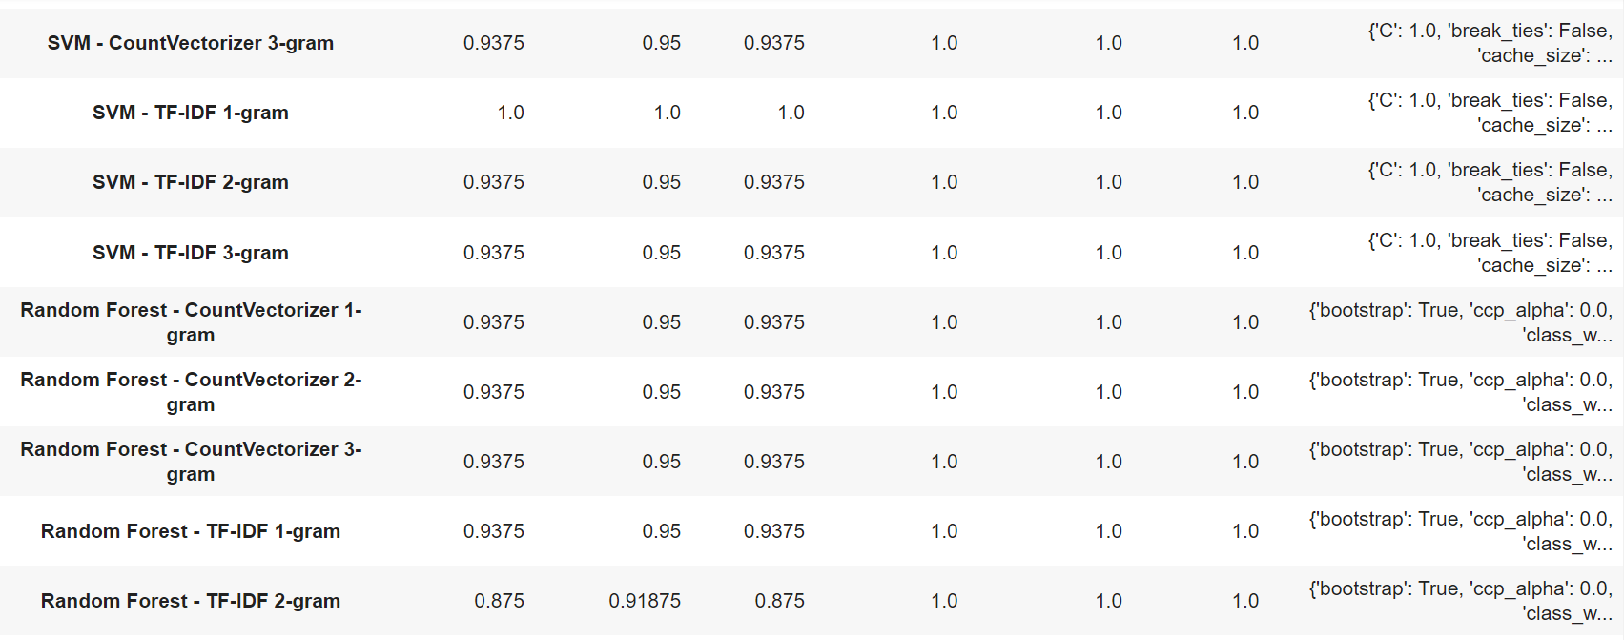

Slide 14
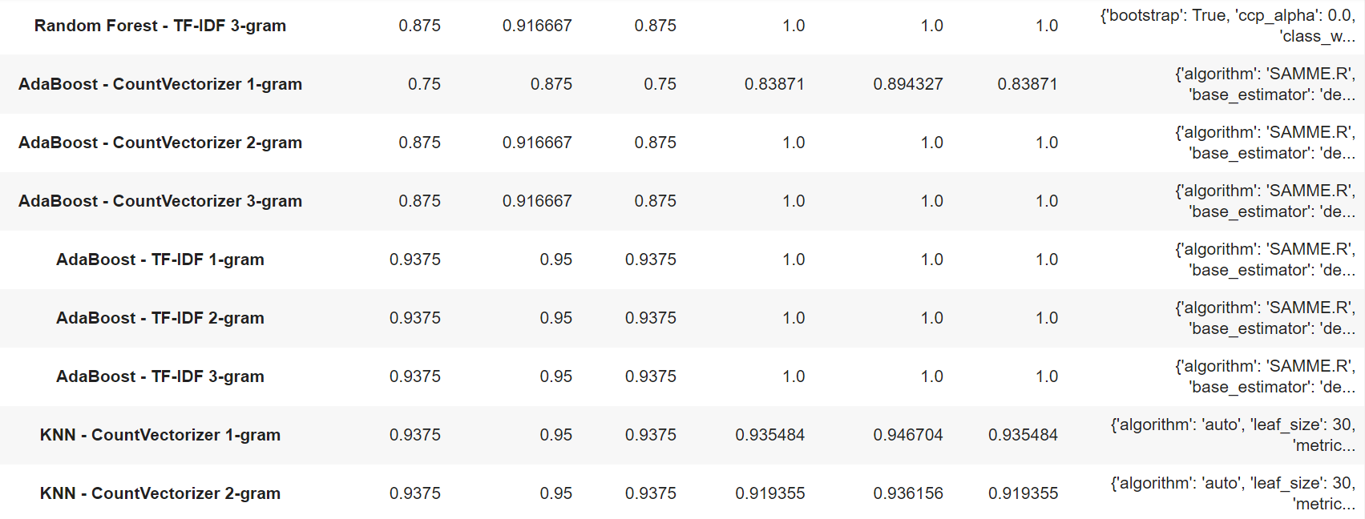

Slide 15
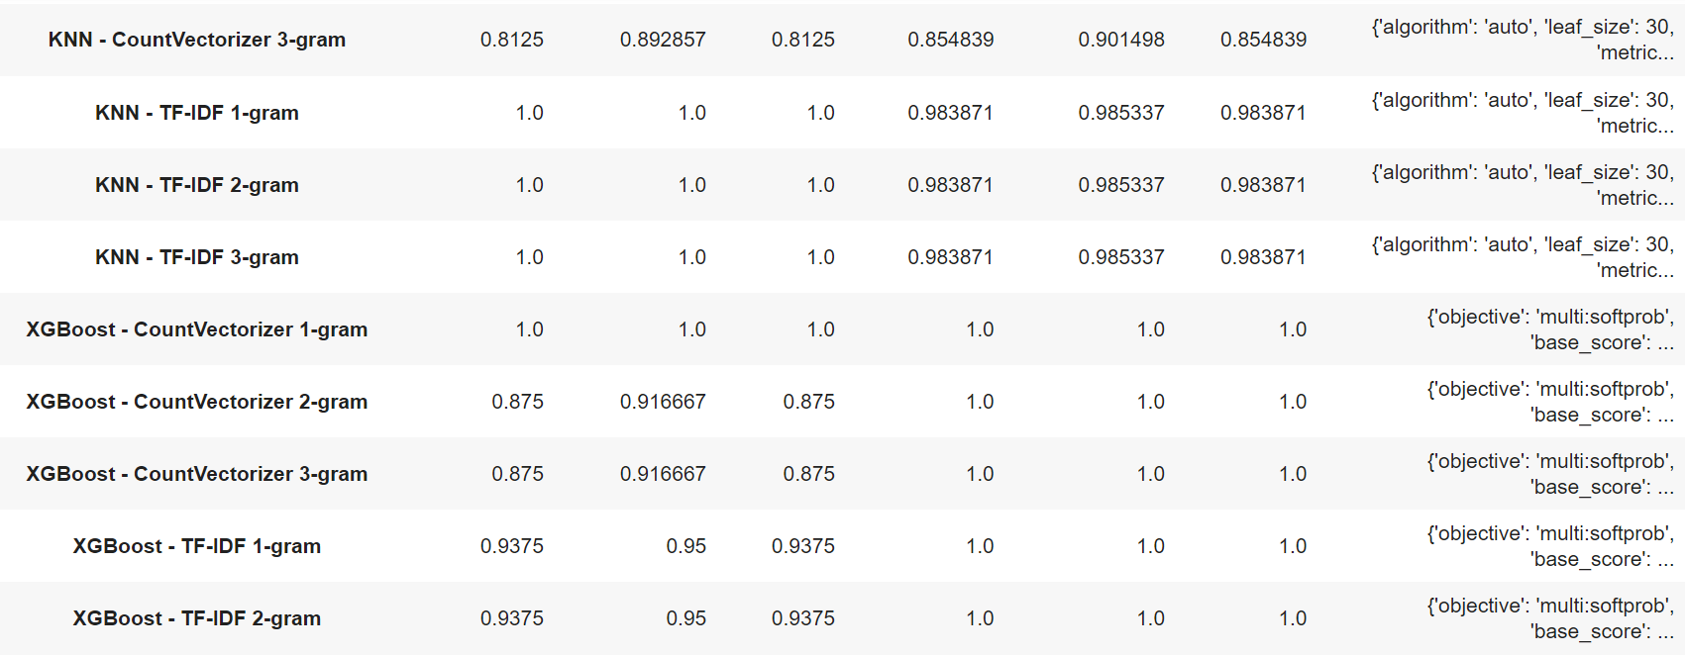

Slide 16
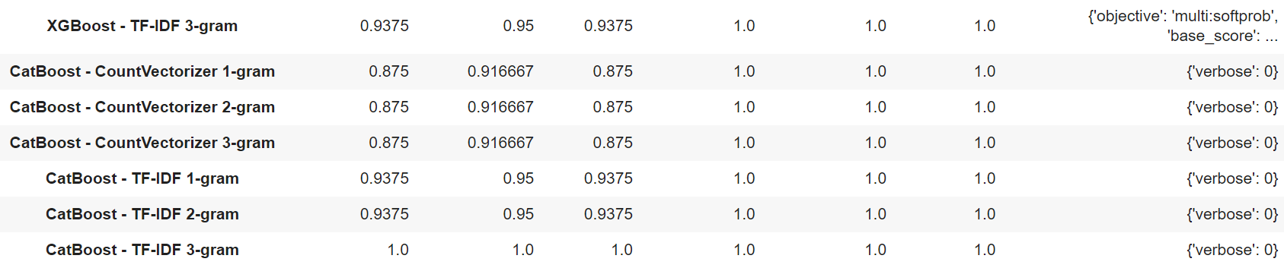

Slide 17

Model Deployment -

Slide 18
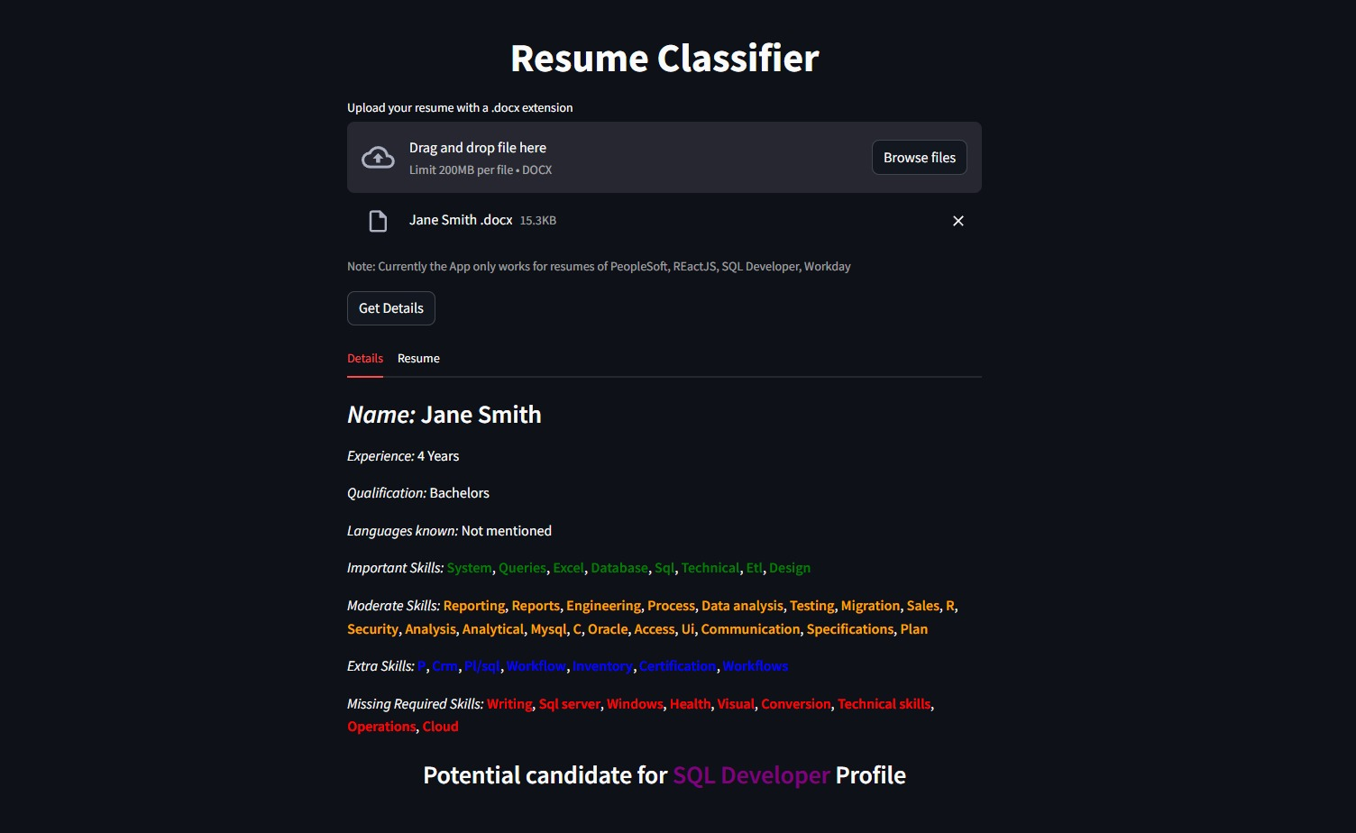

Slide 19
Thankyou

